Slide 2
Prebuilt queries Insights
Notes:
I’ll present today the insights that I gathered from the user research and from my discussions with the head of ux design at Capita, so you can understand the reasoning behind the design that I came up with.

Slide 3
User research – first prototype
Research questions
Participants
Methodology
Do users find this feature helpful, in what situations would they use it?
Does the suggested flow address the user’s needs?
Is the list of query templates suitable for the users?
9 users interviewed
Experienced users and new users working in high pressure situations or that monitor chatter online
Counter terrorism, Police, Politician security, Financial regulators
7 Semi-structured interviews
UK & Canada, Remote
45mins to 1hr
From 16/09 to 25/09
Notes:
A semi-structured interview in UX is a conversation with set questions allowing spontaneous follow-ups based on responses.
Today, I will focus only on the answer to the top 2 questions.
There is a lot to discuss regarding which prebuilt query for which type of users.
I have already told Neil and Phil that Security Commissions users in Canada are keen to have their own set of pre-built queries, but there is more to discuss.
Today, for the sake of time I’d like to talk about the usefulness and usability.

Slide 4
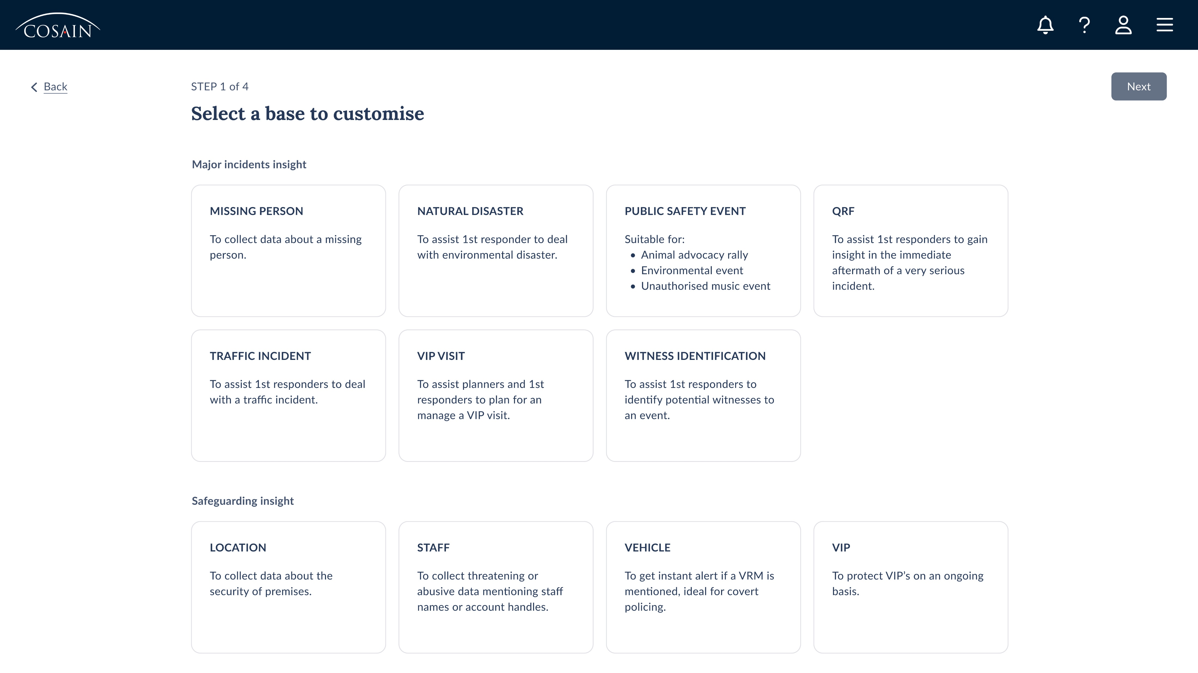
First prototype
Customised for each type of users
Background info about experience with QB
Questions about creation of queries
Show design and ask feedback
4

Slide 5
“I don’t have enough control; I only see part of what is happening”
4 out of 9 users said they wouldn’t use it
Experienced users, 3+ years
Police, CT & Financial regulators

Slide 6
They want more control
Lack of visibility
Want to see the terms and definition in the query template, to amend or to tailor their input
Want to know in which basis their input is added
“I don’t like that I don’t see what I am creating”
“I don’t want to put a name or an address in the “And about section” as I don’t want this to be sent to the internet”
No improvement to their experience
So experienced, they don’t feel the need for a guided way to build a query
They usually reuse an existing query and update it
Notes:
Quotes from users
“I don’t like that I don’t see what I am creating”
“I only see part of what is happening”
“I need to be able to use the suggestions”
“I don’t want to put a name or an address in the “And about section” as I don’t want this to be sent to the internet”
Lack of visibility
They want to know what is already in the query template so they can tailor my input
They what to know what is already in the query template so they can remove what they don’t need
No improvement to their experience
Want to test the query before it is enabled
They don’t know what is happening behind the scenes, they feel too removed from QB to have confidence in the feature.

Slide 7
“It would help us be more reactive”
5 out of 9 users said it would be useful to them
New, intermediate and very experienced users (from 4 months to 9+ years)
Police, CT, Politician security, Financial regulators

Slide 8
“It would help us be more reactive”
They see the value of the guided process to react quickly to various situations:
“Trump will land at Stansted airport in 20 minutes”
Protests and riots following Southport attack
Guided approach is more user friendly than plain QB
Would improve their confidence working with QB
Notes:
- Testing queries ahead of a visit for the royal family, it would have helped them a lot to build the correct query
- This feature would help them with their current workload

Slide 9
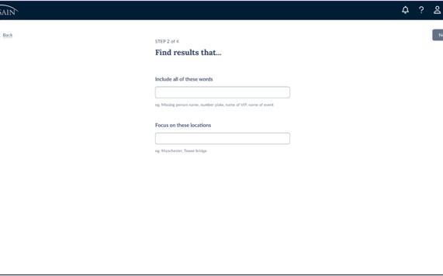
Input fields
Not clear that only one of the fields is mandatory
Unsure whether they can add a definition or not
Confused about the use of speech marks
“Will the pills show after I add the text?”
Suggester:
“Cumbersome, time consuming and intimidating”
Suggester is a Must Have to get any value from the feature
9
Notes:
From experienced users “I would want to add more than a couple of words”
About the suggester:
Long list to go through. Inconvenient when you want to work quickly
Content suggested is not always relevant, they want synonyms or associated words
Cannot multi-select pills
Suggester closes after you add pill

Slide 10
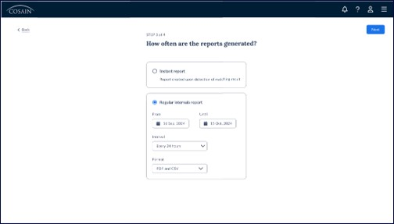
Emails
They need more control over who the query is sent to:
They often create queries for their teams or units, more than 1 email address
Sometimes they create queries that they don’t monitor; they don’t want the reports to be sent to their own email address
I didn’t mention the in-app reports.
10

Slide 11
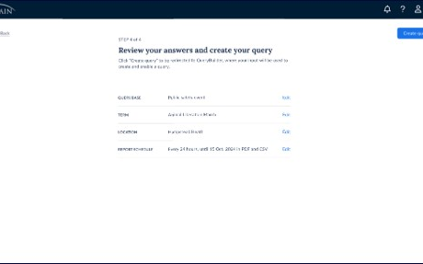
Review
“One stop shop, you see everything in one page, make sure it is all correct and on you go”
Most users see value in reviewing/editing before you create the query
Make sure you didn’t miss anything
Check spelling mistakes
Mixed opinions
Query name: default or custom
Enable the query straight away
11
Notes:
All users bar 1 were excited about this page.

Slide 12
Confusing for users
Concept of Prebuilt query was unclear
I had to explain it to some users, during the process and the end as they didn’t understand the value in the feature.
“How does that improve my experience?” “How is that different from the regular QB?”
They wondered whether they could still use the regular QB
“Can I still access Query Builder as usual?”
“Can I tweak this query further when I am done?”
Notes:
I needed to reassure them that QB as you know it is not going away.

Slide 13
Main insights
A guided process to build queries using pre-populated templates
Add value to QB
Lack of visibility
All interviewed users share the same concerns
More reactive in critical situations
Building process less intimidating
Encourage to interact more with QB
Users need to have more control and visibility
A guided process so far removed from QB is confusing
Must update the design to bring the guided process closer to QB
Notes:
Lack of visibility:
- Unsure about what is happening behind the scenes
- They are too far removed from the application
Same concerns as the user that don’t want to use the feature:
Worry because this easy to use by all users, experienced ones and brand-new ones.
- Same worry as users that said that they wouldn’t use feature

Slide 14
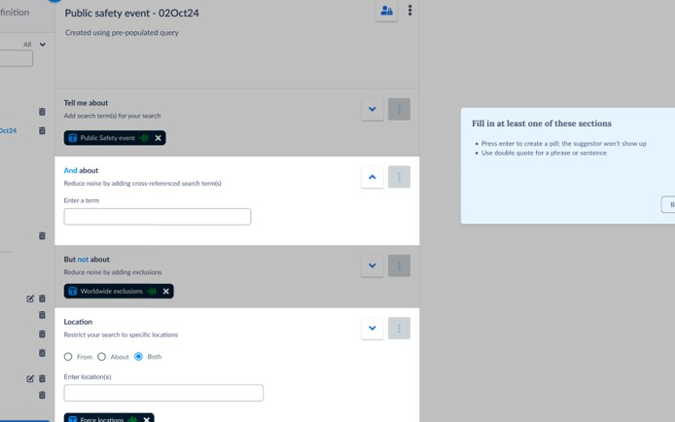
Updated prototype
Feedback from 3 users
Quickly updated using a previous design
3 users that booked their user interviews a few days after my deadline
CT & Financial regulator

Slide 15
Flow needs improvement
Positive
Not disconnected from QB
Like the default options
They scan and read the content of the query
Needs improvement
Confused about the instructions
Unsure about what the next step would be
Prefer a top-down approach
Notes:
- See the query builder and content (review)
- Exit the process at any time (control)
Like the idea of templates
But wouldn’t go through the entire guided process
Would help bring consistency across teams and Security commissions using COSAIN
Need control over who the report is sent to
They want control over the name of the query

Slide 16
Design challenges
Guided process close to the design
Flow must be integrated to design
Allow review
See the content of the query template
Keep them in control
Minimum to zero design change to QB
Cannot invest too much time into redesigning an application that is due for a redesign soon
Code is complex and old
Any code change will be discarded
Improvements as part of updated design
16

Slide 17
Multiple iterations and chats with Head of design
Overlay is not accessible
Highlighting a section is challenging especially, Suggestor, Inclusion panel
Sections do not fit on a single screen eg: email
We don’t want to create something that will be deleted afterwards
QB is too complex for more elements to be added to or on top of it
Notes:
Any other way to highlight the sections is complicated because the sections move and open on the side

Slide 18
Suggested design
Extensible UX design
Updated as we rebuild QueryBuilder
We will be able to guide them until the last step
We still have a populated query:
Definitions and terms
Report schedule, with time and format
Default name
Notes:
Can the query be enabled by default when the user create the query template
Descriptions need work. Do they have a CT element etc, more specific – fit on 2 lines

Slide 19
Query templates
Not design related, but must be shared with Ops team

Slide 20
Query templates: Suggestions
Other basis: Crime, Crime in action and UK Election
More granularity about the concept of VIP (eg: Pop star, Embassador, Royal family)
1 user: Illegal music event doesn’t return anything valuable
Ability to customise the list to their needs (beyond MVP)

Slide 21
Concerns about pre-set definitions
Descriptions are all very oriented to planners and 1st responders, do they have a CT element?
When and how are they updated?
National definitions: very Westminster oriented and out of date content
Biais eg: Misogyny
Notes:
“Bob mentions a female politician that was receiving abuse because of her weight, and it took him some time to recognise that some of that abuse was misogynist abuse. He went through an education process and subsequently tailored his query to incorporate his learning about potential background, racial, gender bias, and the query started picking up a lot of material that wasn't being picked up before "our queries need to be as as specific and as relevant to the person as they can be to be really useful“

Slide 22
Thoughts
We need to inform users when definitions are updated to maintain confidence in the functionality.
Update descriptions or content if they have a CT element.
Are the definitions free from racial or gender bias?

Slide 23
Scottish parliament
Confirm that all the suggested topics are relevant to them
Would also like to have:
Public safety event
QRF
Traffic incidents
To monitor protest activities on Princes street
If something happen close to Queen Elisabeth’s house
To help redirect traffic away from (eg) the train station
Monitor incidents that could affect staff going to and from the building
Notes:
Default topics for the Polician security category - VIP Visit
Location safeguarding
Staff protection
VIP protections

Slide 24
Other feedback
No more than 20% of presentations should use secondary colour

Slide 25
Other feedback
Frustration over known issues
Cannot clone a definition
Multi-select in suggester
Suggestion of synonyms or similar words
National definitions
Very Westminster oriented
Some words are related to coronation, they would like to remove that
They like the user feedback sessions:
Makes them feel like they are part of the improvement process
Glad to see the product progressing
“We feel like other products are asking you to catch up to them, COSAIN is progressing with us”
“I like to see the direction that the product take”
“These user feedback sessions are a real bonus of COSAIN”
Notes:
Illegal music events do not return results because they are underground events

